Slide 1
WE PBIS Expectations
WE are Respectful.
WE are Responsible.
WE are Safe.
W.E. PBIS Flowchart
Observe Problem behavior
to determine if behavior is
Minor or Major
Minor
Major
Problem behavior observed 1st time
~Redirect the student with individual interventions/behavior strategies and reteach expected behavior
Teacher/Staff Managed Behavior | Office Managed Behavior
Disrespectful/Abusive and Inappropriate Language ~Mean words to others ~Talking back ~Not following expectations repeatedly ~Misuse of technology | Abusive Language ~Targeted taunting (race, gender, etc) ~Inappropriate language ~Inappropriate websites/ damaging technology
Disruption/Physical Aggression ~Horseplay gone too far ~Distracting other students ~Making repeated noises ~Throwing small objects ~Repeatedly calling out | Disruption/Physical Aggression ~Biting, pushing, shoving, etc. that causes harm ~Kicking/hitting objects ~Screaming/shouting ~Throwing objects that can cause harm
Defiance or Non-Compliance ~Not completing classwork ~Not following directions after being prompted ~Leaving area without permission | Defiance/Threat or Intimidation/Bullying ~Verbal threats of aggression against another person, self, or school ~Complete refusal to comply that causes disruption ~AWOL: leaving the classroom/lunch area/school without permission
Property Damage or Vandalism ~Minor = w/little or no value | Vandalism of Personal/School Property ~Major = expensive
Theft ~Minor = w/little or no value | Theft ~Major = expensive
 | Possession of Weapons/Dangerous Items ~Knives, guns, lighters, matches, bullets, look a-likes, substances, drugs, or paraphernalia, etc.
Teacher calls admin to remove student (if necessary)
~Admin contacts guardians and document in PLP
Problem behavior observed 2nd time
~Use Limit Setting and Logical Consequences
~Reteach expectations
Admin enters referral into SWIS
~Click send for review at the bottom of referral
~Involve Behavior MTSS team
Problem behavior observed 3rd time
~Think sheet/SWIS referral to PBIS team
~Parent Contact & document in PLP
~Submit a STOIC Coach Behavior Request
Administrative Intervention and Consequence
Problem behavior observed 4th time
~Admin referral/Think Sheet/SWIS referral as Major to PBIS team
~Parent Contact & document in PLP
PBIS Team review of data and interventions ~PBIS team meets monthly to discuss student behavior and additional interventions
Teacher Strategies
-Re-Teach/Practice
-Change of Seating
-Student Conference
-Close proximity
-Verbal praise
-Remove distractions
-Offer prompting cue
-Parent/teacher conference
-Provide Physical Comfort
-Time with Teacher or Support Staff
-Loss of opportunity
Admin determines if incident needs to be documented in Behavior section of Infinite Campus

Slide 2
Strategy/ Response | Definition | Examples
Re-Teach/ Practice | Instruct student on expected behavior, model the expected behavior, have student practice expected behavior and acknowledge the expected behavior. | Remind students of expectations or rules prior to activity or transition, have students repeat/share expectations or rules regularly, have student exhibiting challenging behavior name the expectations and model expected behavior, acknowledge other students for exhibiting appropriate behavior.
Verbal Reminder | Initial intervention when challenging behavior first occurs. Give student signal to engage in an alternate, appropriate behavior in a brief and concise manner without showing emotion or judgment. Only use once for each occurrence. | Remind student of appropriate behavior at the first sign of challenging behavior occurring.
Change of Seat | Move student to another work area where they can still be actively engaged such as preferred work desk/table, the floor, teacher’s desk, or a special table. | Provide seating that provides for individual space and needs, teach students to recognize when they need a quiet work area and how to ask for one, Give student exhibiting challenging behavior a choice of a “better” work space, allow student to sit in a special area to complete a task.
Provide Physical Comfort | Provide appropriate soothing to a student in the form of a hug, rocking, pat on the back, etc. | If student is crying, provide comfort by sitting with them and rubbing/patting their back to calm them down and then engage them back into an activity.
Time with Teacher or Support Staff | Student spends one to one time with his/her teacher or an administrator, counselor, behavior specialist, etc. | Have student spend quality one on one time with teacher or support staff discussing challenging behavior and also building a nurturing and responsive relationship.
Prompting | A visual, auditory or physical cue is presented to a student to facilitate a given response. | Play clean-up music to signal center time is ending and time to clean up, show a student a visual cue card prior to a transition beginning, or if a student is learning to write, provide a dot on the beginning of each line where the student should start printing each letter.
Visual Schedule | Provide/prompt student with a pictorial or written organized schedule for the day or a particular task. | Have schedules and routines posted with pictures and words throughout the classroom. Review these schedules and routines frequently with the class. Use individual cue cards with pictures and words to remind a student exhibiting challenging behavior of appropriate behavior or what is happening next to prevent challenging behavior from occurring.
Loss of Item | Teacher removes the student’s access to a reinforcing object, activity or status for a specific period of time. | During an activity, the teacher puts away a board game a student is playing with after exhibiting challenging behavior. Student is unable to play with board game until the next day. Student loses five minutes of recess. Loss of item should only be used after other strategies have been tried.
Student Conference | Student privately meets with teacher to discuss challenging behavior and works with student to improve undesired behavior. | Meet with student to discuss the incident, what expectation was not followed, and what the expectation should be displayed in the future. Have student reflect on behavior. Determine appropriate strategy or consequence (if necessary) needs to occur to help prevent challenging behavior in the future.
Family Contact | Teacher notifies family member by phone, email, letter or conference to discuss student’s challenging behavior. | Make positive contact with families before challenging behaviors occur, contact family member to discuss challenging behavior.

Slide 3
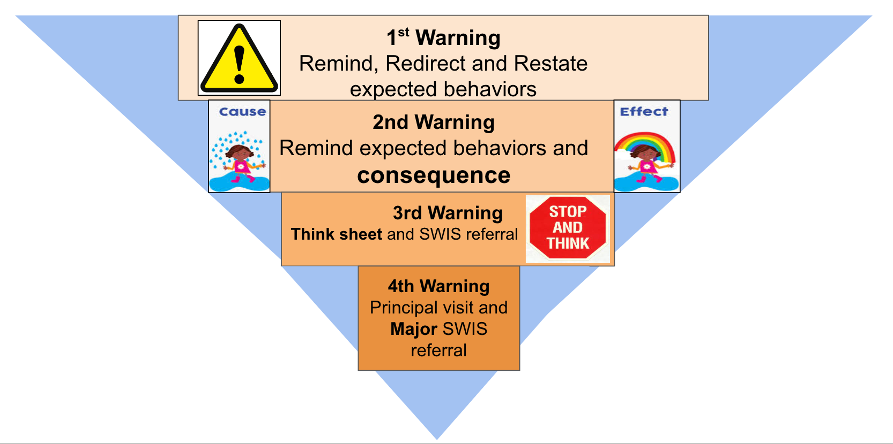
Accountability Hierarchy
for students

Slide 4
2nd Warning: Logical Consequences - Allows teachers to set specific limits for behavior so students can learn the expectations
Expectation Reminders | Logical Consequence Examples: “If you choose to…”
Cafeteria Allow others to sit with you Voice level 1 or 2 when lights are on, and voice level 0 if lights are off Clean up your area Sit on your bottom | have rude behavior when peers ask to sit with you, then you’re choosing to sit alone use outside voice when lights are on or talk when the lights are off, then you’re choosing to have silent lunch leave your area messy, then you choose to stay and help the custodians clean up sit in an unsafe way, then you’re choosing to sit picnic style or in a regular chair
Hallway Keep hands/feet to yourself Voice level 0 or 1 Close lockers quietly Walk and go directly to your destination | touch or push/kick others, then you are choosing to walk with the teacher use level 2 voice, then you’re choosing to practice level 0 voice during free time slam lockers, then you’re choosing to go back and help clean the lockers run or go somewhere without permission, then you’re choosing to wait until a teacher can walk with you
Restroom Allow privacy Voice level 0 or 1 Leave no trace Return to class quickly | look over/crawl under the stalls, then you’re choosing to use another bathroom alone use a level 2 voice, then you’re choosing practice level 0 during free time leave a mess, then you’re choosing to help the custodians clean up go somewhere else without permission, then you’re choosing to always go with a partner

Slide 5
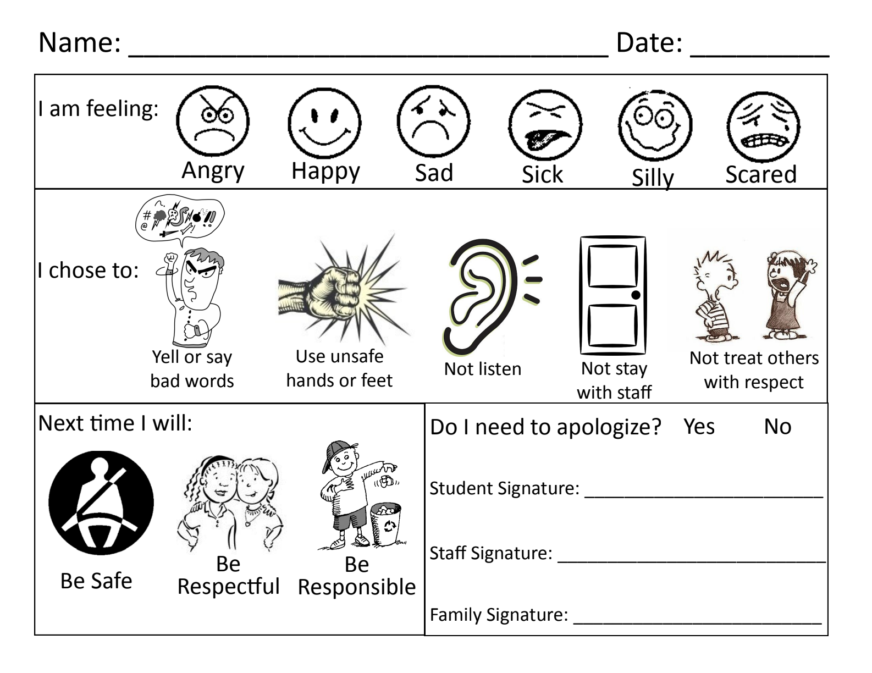
WE PBIS Think Sheet Referral Form
Student completes top section Think Sheet and takes home for parents to sign.
Teacher completes bottom section Referral Form and gives to PBIS Team to add to SWIS
(PBIS behavior referrals are not documented in IC)
—------------------------------------------------------------------------------------------------------------------------

Slide 6
Goals of Misbehavior Chart
Use this chart to help you determine students’ motivation for misbehavior.
A child’s lack of one or more of The Crucial C’s might explain unexpected behaviors.
Child’s Goal | What child might believe and feel | How adult might feel and respond | Child's response to adult's action | Crucial C (what a child might need) | Suggested Strategies/Responses
Attention “Look at me” | I only count when I am being noticed or served. I feel insecure or alienated | I feel irritated and annoyed. Remind: scold, nag, and coax. | Temporarily stops the behavior when given attention, but soon continues May begin a new behavior to gain attention. | CONNECT Child needs to believe they belong and feel secure | ~Ignore when possible ~Give attention in unexpected ways and for positive behavior ~Plan activities together ~Ignore the behavior, NOT the child ~Teach cooperation
Power “I’m the boss” | I have power only when I show you that you can’t make me/I can do whatever I want, or when you do what I want you to do. I feel inadequate, dependent, others are in control | I feel provoked, angry, and challenged. Fight: "i'll make him/her do it" or "You can't get away with it." | Behavior intensifies when reprimanded. Defiant child wants to win/be boss. | CAPABLE Child needs believe they are in control of themself and to feel competent | ~Allow voice and choice so student feels heard and can display power constructively ~Grant legitimate power ~Delegate responsibility so student feels sense of responsible power ~Avoid and defuse confrontations/Do not try to win ~Teach Self-Reliance
Revenge “I’ll get even” | I don't have power but l'll count if I can hurt others as I feel hurt. “I’ll show you”, “I knew you were against me” I feel insignificant | I feel hurt, disappointed and angry Punish: "How can he/she do this to me?" “I will teach you a lesson”. | Wants to get even, makes self-disliked, or seeks further revenge. | COUNT Child needs to believe they matter and can make a difference, and feel valuable | ~Maintain caring/trusting relationship with child ~Avoid retaliation ~Take time to help child ~Teach child how to express hurt and anger appropriately ~Teach child how to contribute/that their contributions matter
Display of inadequacy (Avoidance of Failure) “I give up” | I can't do anything right so I won't try to do anything at all. “I am no good” I feel inferior, useless or hopeless. | I feel hopeless and discouraged Give Up: "it’s not use.” | No reprimand therefore no reaction. Feels more hopeless/passive. no improvement | COURAGE Child needs to believe they can handle what comes, and feel hopeful | ~Encourage efforts/notice strengths/ignore the negative ~Maintain faith in a child's ability ~Don't give up, pity or criticize ~Foster friendships to end social isolation, if present. ~Focus on past successes ~Provide opportunities for guarantee successes. ~Teach resilience
*Remember, behaviors are attempts to get a need met.
Misbehavior can be thought of as a response to not having The Crucial C’s.
Use encouragement, limit setting and logical consequences to help children learn they can get their needs met in respectful, responsible and safe ways.
Created from The Crucial C’s and Rudolf Dreikurs’ Goals of Misbehavior. Amy Lew and Betty Lou Bettner, 1995

